Slide 1


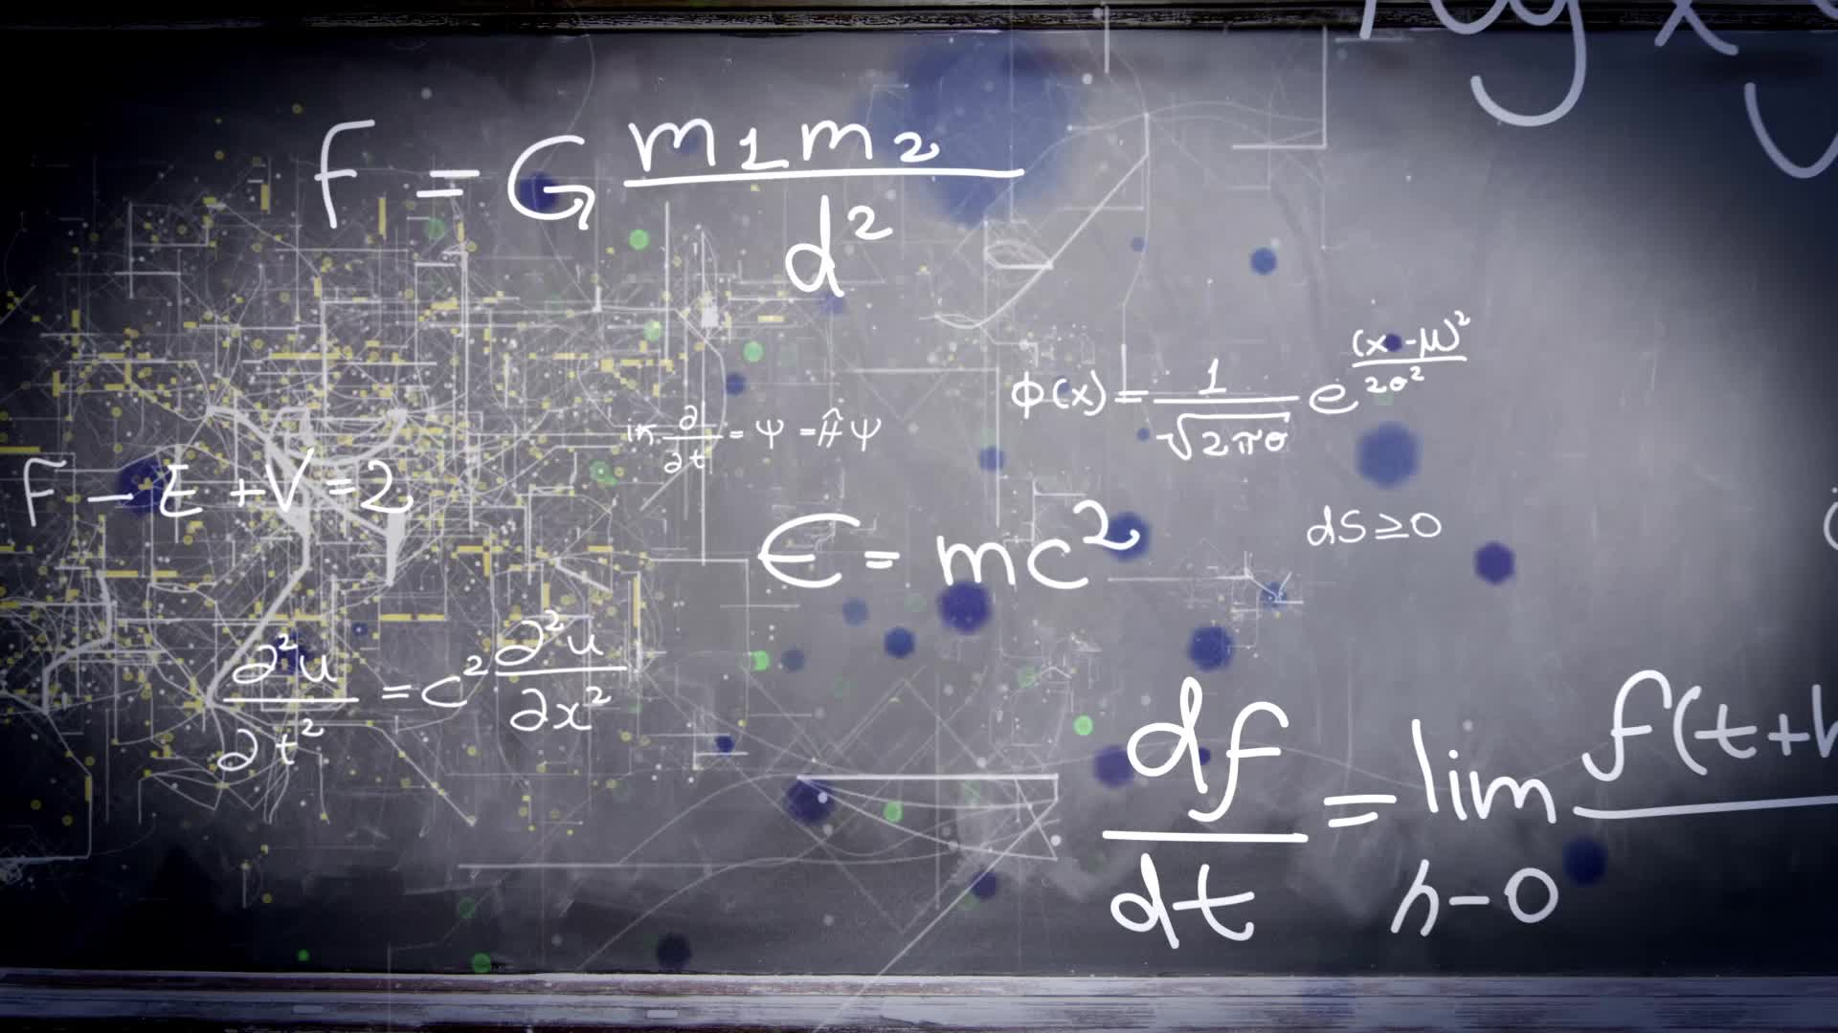
The Mathematics of Extreme Events
Dr Christian Rohrbeck & Dr Karol Bacik

Slide 2
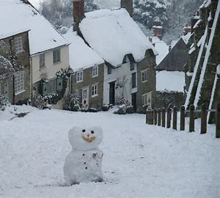



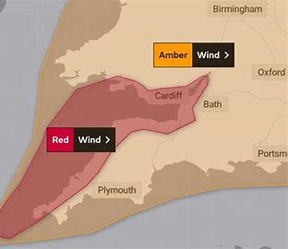

What Do We MEAN BY EXTREME EVENTS?

Slide 3
What are we interested in?
How often do these extremes happen, aka frequency?
For some cases, we can calculate it exactly:
The chance to win the lottery is 1 in 45,057,474.
However, we have to estimate the frequency in many situations.
We also have to predict the severity of an extreme event:
What is the wind speed our house has to withstand?
How high may flood levels be in the next 100 years?

Slide 4
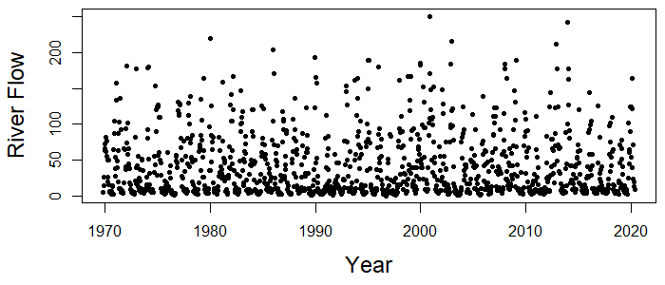
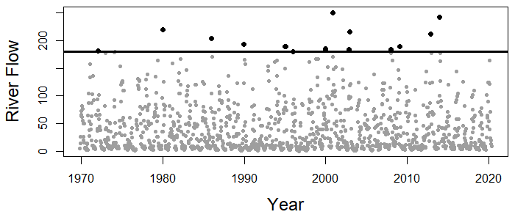
What ARE WE INTERESTED IN?
Recorded River Flow for the River Avon at Bathford between 1970 and 2020

Slide 5
Aim of this class
We will introduce two models for the frequency of an extreme event.
These models help to address questions such as
How many years until the next white Christmas?
How many earthquakes are recorded worldwide within a year?
We also consider the estimation of these models

Slide 6
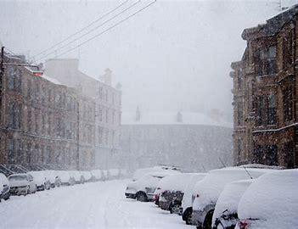
How many years until the next white Christmas?
Let p be the probability of a white Christmas in any considered year.
Suppose that we just experienced a white Christmas.
The probability that we have to wait 1 year is p.
Snow again next year
The probability that we have to wait 2 years is (1-p) * p.
No snow next year and Snow the year after
The probability that we have to wait 3 years is (1-p) * (1-p) * p.
No snow in Year 1 and No snow in Year 2 and Snow in Year 3

Slide 7

How many years until the next white Christmas?
We find that the probability that we have to wait k =1,2,3,.. years is
$$p{(1−p)}^{k−1}$$
For South-West England, a white Christmas was recorded for the following years
1961, 1964, 1970, 1981, 1985, 1990, 1993, 1995 1996, 1999, 2000, 2001, 2004, 2013
How can we estimate the probability p ?

Slide 8
How many years until the next white Christmas?
To estimate p, we can perform the following two steps:
Calculate the average time between consecutive white Christmases
For South-west England, the number of years between white Christmases were
3, 6, 11, 4, 5, 3, 2, 1, 3, 1, 1, 3 and 9
So the average number of years between white Christmases was 52 / 13 = 4.
The estimate for the probability p is then (1 / average time calculated in Step 1)
So our estimate for p is 1 / 4 = 0.25.

Slide 9
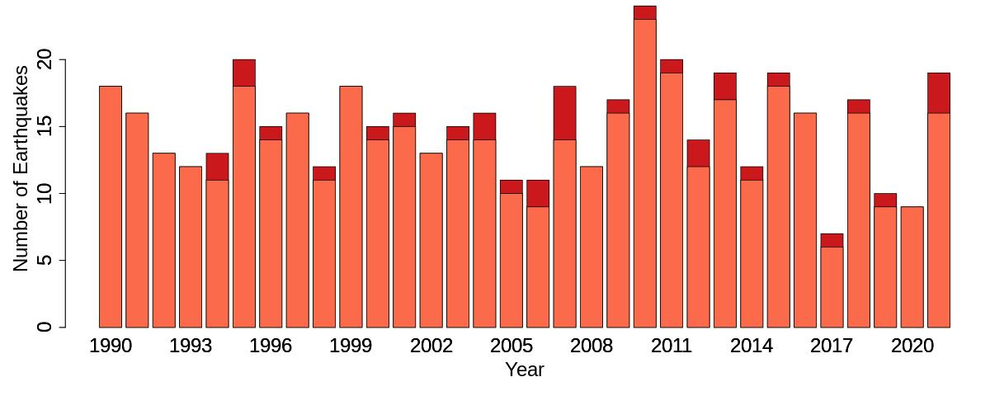
Number of earthquakes worldwide
The United States Geological Survey provides the number of earthquakes over the past 32 years.
Light colours indicate the earthquakes with a magnitude between 7.0 and 8.0, and darker colours are earthquakes above 8.0 on the Richter scale.

Slide 10
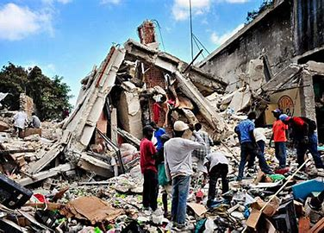

Number of Earthquakes Worldwide
Interest lies in modelling the yearly number of earthquakes with a magnitude of 7.0 or above
A popular model for counts defines the probability that we will record k =0,1,2,3,.. earthquakes as
$$\frac{q^{k}}{k!}∗\exp\left(−q\right),$$
where the parameter q > 0 is unknown.

Slide 11
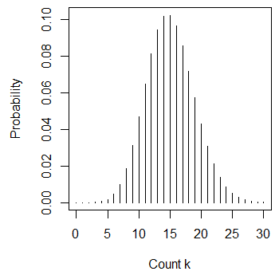
Number of earthquakes Worldwide
We can estimate q as the average number of earthquakes within in a year.
For the given data, we estimate q as 15.1.
The plot on the right shows the probabilities for the different values of k.
This model allows for any positive count, even 10,000,000.

Slide 12
Exercise 1
Consider the modelling of heatwaves (these are extended periods of hot weather).
Which aspects may we be interested in modelling?
Hint: Remember the concepts of frequency and severity.
How often do heatwaves occur? -> Frequency
How long are the heatwaves in days? -> Severity
How high will the temperatures be? -> Severity

Slide 13
Exercise 2
For the River Avon at Bathford, a river flow above 180 m^3/s was recorded in
1972, 1979, 1985, 1989, 1995, 1999, 2000, 2002, 2008, 2009, 2012 and 2013
Using one of the methods introduced today, calculate the probability p that the river flow exceeds 180 m^3/s in a year.
What is the estimated probability that the next time the river flow exceeds 180 m^3/s is in 2024?
Do you think it is reasonable to assume that p is constant between 1972 and 2013?

Slide 14
Exercise 3
We are interested in modelling the number of periods with extreme heat for the city of Dresden in Germany.
The total number of heatwaves for the years 2000 to 2018 was 36.
Define a model for the number of heatwaves within a year and estimate any unknown model parameters.
What is the probability that the number of heatwaves in a year is less than 2?
What is the probability that there is at least 1 heatwave in a year?

